Slide 1



Software engineering (Undergraduate)
Chapter 4 quality assurance and engineering
Course Name software quality and testing
CSC 4133
(Undergraduate)
M. Mahmudul hasan
Assistant Professor, CS, AIUB
http://www.dit.hua.gr/~m.hasan

Slide 2
Quality Assurance
MMH
QA focus on correctness aspect of quality, and dealing with defects
QA activities can be classified into three generic categories –
Defect Prevention: QA activities prevent certain types of faults from being injected into the software since errors are the missing/incorrect human actions that lead to injection of faults into software systems (default values, options to select)
Defect Reduction: QA activities detect and remove certain faults once they have been injected into the software systems.
Defect Containment: control defect through fault tolerance, failure prevention, or failure impact minimization to assure software reliability and safety (e.g. auto save option)

Slide 3
Defect prevention
MMH
Defect prevention can be done by two generic ways:
Error source removal (known error sources)
Eliminating certain error sources such as eliminating ambiguities or correcting human misconceptions, which are the root causes for errors and remove through education and training (people-based solution)
Error Blocking
Fault prevention or blocking by directly correcting or blocking these missing or incorrect human actions (i.e. missing/incorrect actions, e.g. user can not give 0 value to the divisor attribute)
This will result the direct intervention to block errors (fault injections prevented)
Systematic defect prevention via process improvements
If imprecise designs and implementations, tools and technology that deviate from product specifications or design intensions are the causes for faults, formal methods can help prevent such deviations

Slide 4
Defect reduction
MMH
It is unrealistic to expect the defect prevention activities to be 100% effective in preventing accidental fault injections. Following are the techniques to remove as many faults as possible
Inspection Method to Reduce Defects
The most commonly used static technique uses critical reading & analysis of software code, designs, product specifications, test plans, etc.
Formality and structures of Inspections varies in
Informal reviews/walkthroughs (self-conducted, independent, pass around, canteen discussion)
Formal Inspection are typically conducted by multiple human inspectors through some predefined coordination of process.

Slide 5
Defect reduction
MMH
Testing Method to Reduce Defects
Involves the execution of software and the observation of the program behavior/outcome
If a failure is observed, the execution record is then analyzed to locate & fix the fault(s) that caused the failure.
Other techniques & Risk identification Method to Reduce Defects
Formal model-based analyses
Boundary value analysis (e.g. loop condition check)
Control flow and data flow analyses
Simulation and Prototyping

Slide 6
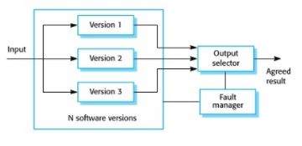
Defect containment
MMH
Defect reduction activities can only reduce the number of faults to a fairly low level, but not completely eliminate them (because of the large size and high complexity of most software systems in use today as complete testing is not possible)
The containment measures focus on the failures by either containing them to local areas so that there are no global failures observable to users, or limiting the damage caused by software system failures (e.g. exception handling)
Defect Containment can be done in two generic ways:
Software fault-tolerance
Recovery: rollback & redo
NVP: N-Version programming (fault blocked)
Safety assurance and failure containment
MMH

Slide 7
Defect containment
MMH
Safety assurance & failure containment
Safety : Accident free (e.g. auto pilot safety eliminate pilot error)
Accident: Failure with severe consequences
Hazard: Pre-condition to accident
Safety Assurance: Hazard analysis, hazard elimination/reduction/control, damage control
MMH

Slide 8
QA in software process
MMH
Process variations
Waterfall development process
Iterative development process (QA in increments)
Spiral development process (QA & risk management)
Agile development process (XP- test driven development pair programming)
Maintenance processes (focus on defect handling)
Development components
Requirement
Specification
Design
Coding
Testing
Release
Mega-process
Initiation
Development
Maintenance
Termination

Slide 9
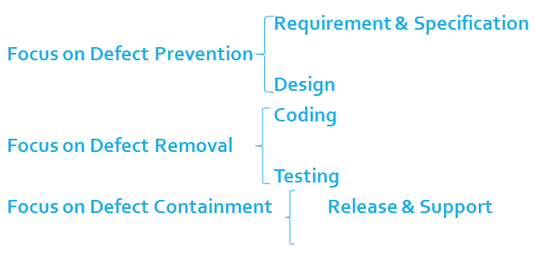
QA in software process
MMH

Slide 10
QA Activities: Mapping from DC view to V&V view
Slide - 10
MMH
DC (defect-centered) view | QA activity | Validation(external focus) &Verification (internal focus) view
Defect prevention |  | Both, mostly indirectly
 | Requirement-related | Validation, indirectly
 | Other defect prevention (Project Plan) | Verification indirectly
 | Formal specification | Validation, indirectly
Defect Reduction | Testing type | Both, but mostly verification
 | Unit | Verification
 | integration | Both, more verification
 | system | Both
 | acceptance | Both, more validation
 | beta | Validation
Defect Containment |  | Both, but mostly validation
 | Operation | Validation
 | Design & implementation | Both, but mostly verification

Slide 11
Software quality engineering (SQE)
MMH
To meet or exceed these quality expectations through the selected and execution of appropriate QA activities while minimizing the cost and other project risks under the project constraints
The SQE process forms an integral part of the overall software engineering process, where other concerns, such as cost and schedule are also considered and managed.
SQE activities-Generic Testing Process (Systematic testing based on formal models)
Pre-QA activities: Quality Planning/Test Planning
Most of the key decisions about testing are made during this stage
Set specific quality goals (high-level activities to test planning)
Identify quality perspective and expectation: meaningful to target customers and users
Select direct quality measures: quantified measure of the selected quality attributes (efficiency, reliability, usefulness target in quantified values)
Assess quality expectations vs. Cost: cost of achieving different quality goals

Slide 12
Software quality engineering (SQE)
MMH
Form an overall QA strategy (low-level activities to test preparation, test case)
Select appropriate QA activities to perform
Choose appropriate quality measurements and models to provide feedback, quality assessment and improvement
Test Procedure Preparation
Preparing test cases (micro-level)
Test case is a collection of entities and related information that allows a test to be executed or a test run to be performed
Test case allocation
Sequencing of the individual test cases from simple to complex

Slide 13
Software quality engineering (SQE)
MMH
Preparing test suit (macro-level)
The collection of individual test cases that will be run in a test sequence until some stopping criteria are satisfied is called a test suite.
Involves the construction and allocation of individual test cases in some systematic way based on the specific testing techniques used.
Another way to obtain a test suite is through reuse of test cases for earlier versions of the same product. This kind of testing is commonly referred to as regression testing.
In general, all the test cases should form an integrated suite, regardless of their origin, how they are derived, and what models are used to derive them.

Slide 14
Software quality engineering (SQE)
MMH
In-QA activities: Test Execution
Executing planned QA activities and handling discovered defects
Collect failure information: What /where/when/severity/etc.
Documentation of testing activities to check future execution results
Organizations use template for test execution measurements
Post-QA activities: Quality Measurement, Assessment & Improvement
Follow-up activities - providing feedback & identifying improvement potentials
“Post-QA” does not mean after the finish of QA activities. In fact, many of the measurement & analysis activities are carried out parallel to QA activities after they are started. In addition, pre-QA activities may overlap with the QA activities as well.

Slide 15
Test case
MMH
Project Name: |  |  | Test Designed by: Name
Test Case ID: FR_10 |  |  | Test Designed date: date
Test Priority (Low, Medium, High): Medium |  |  | Test Executed by: Name
Module Name: login session |  |  | Test Execution date: date
Test Title: verify login with valid username and password
Description: Test the website login page
Precondition: user has valid username and password Dependencies: if any
Test Steps | Test Data | Expected Results |  | Actual Results | Status (Pass/Fail)
Go to the site Enter username Enter password Click submit | Username: urs99 Password: 321 | User should login into the application |  | As expected | Pass
Post Condition: User is validated with database and successfully login to account. The account session details are logged in the database
MMH

Slide 16
Testing teams: organization & management
MMH
Customers and users, who may also serve as testers informally for usability or beta testing
Independent professional testing organizations as trusted intermediary between software vendors and customers
Testers and testing teams can be organized into various different structures:
Vertical model: would recognize around a product, where dedicated people perform one or more testing tasks for the product
Horizontal model: performs one kind of testing for many different products within the organization
Mixed model: often used in large software organizations

Slide 17
references
MMH
Software Testing And Quality Assurance – Theory and Practice - Kshirasagar Naik & Priyadarshi Tripathy
Software Quality Engineering: Testing, Quality Assurance and Quantifiable Improvement - Jeff Tian

